Slide 1


Alexander Leano
19/03/2024

Slide 2

Outline
Executive Summary
Introduction
Methodology
Results
Conclusion
Appendix

Slide 3
Executive Summary
Summary of methodologies
Data collection via API and Web Scraping
Exploratory Data Analysis with Data Visualization
Exploratory Data Analysis with SQL
Interactive Map with Folium
Dashboards with Plotly Dash
Predictive Analysis
Summary of all results
Exploratory Data Analysis results
Interactive maps and Dashboard
Predictive results

Slide 4
Introduction
Project background and context
The project aims to predict if the Falcon 9 first stage will successfully land.
Falcon 9 rocket launch cost 62 million dollars when other providers cost upward of 165 million dollars each.
The price difference is explained by the fact that SpaceX can reuse the first stage.
By determining if the stage will land, It is possible to determine the cost of a launch.
This information is interesting for another company if it wants to compete with SpaceX for a rocket launch.
Problem to be solved
Identification of factors that influence the landing outcome.
Find the relationship between variables and how they affect the outcome.
Increase the probability of landing success by finding the best condition needed.

Slide 5

Section 1

Slide 6
Methodology
Executive Summary
Data collection methodology:
Request data from the SpaceX API (https://api.spacexdata.com/v4/rockets/).
Web scrapping from Wikipedia.
Perform data wrangling
Dropped unnecessary columns and labeled them for classification models.
Perform exploratory data analysis (EDA) using visualization and SQL
Perform interactive visual analytics using Folium and Plotly Dash
Perform predictive analysis using classification models
Find the best hyper-parameters, compare the different models

Slide 7
Data Collection
Dataset collected by REST API:
URL: https://api.spacexdata.com/v4/rockets/
Using of get request, decode the response content as JSON and turn it into a Pandas data frame using the json_normalize() method. Cleaned data, checked and filled in missing values that were needed.
Web scraping:
List of Falcon 9 and Falcon Heavy launches (9th June 2021). URL: https://en.wikipedia.org/w/index.php?title=List_of_Falcon_9_and_Falcon_Heavy_launches&oldid=1027686922
Use of BeatifulSoup for extraction of record as HTML table, parsing and converting to a Pandas data frame for further analysis
Link to workbook document

Slide 8
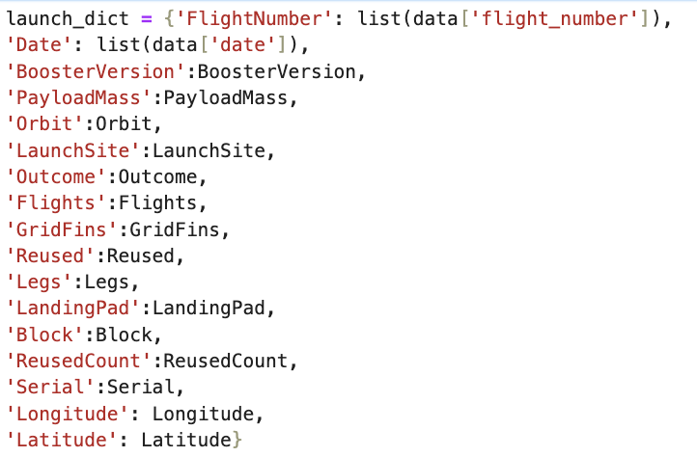
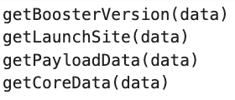
Data Collection – SpaceX API
1. Getting a response from API
4. Create a dictionary with data
5. Create a dataframe
2. Convert response to JSON file
6. Filter dataframe
3. Convert response to JSON file
7. Export to file
Link to workbook document

Slide 9
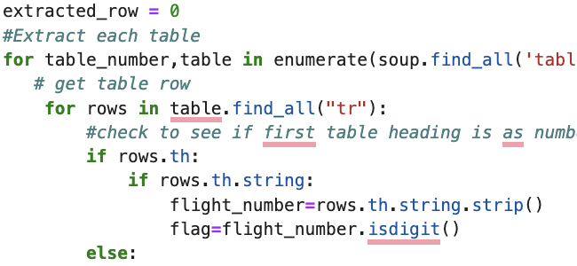
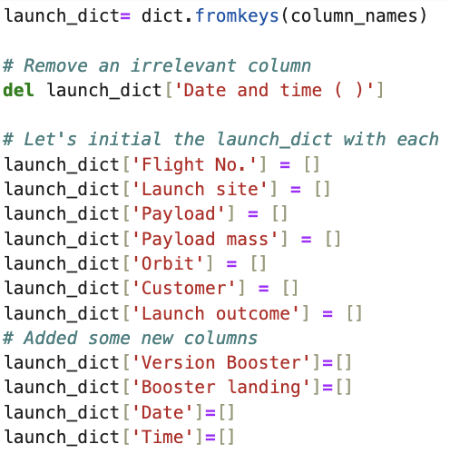
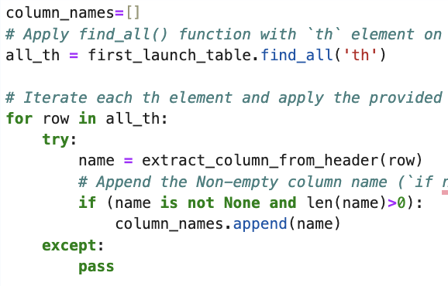
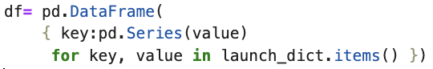
Data Collection - Scraping
1. Getting a response from HTML
6. Add data to keys
5. Create a dictionary with data
2. Create a BeautifulSoup Object
3. Find all tables
See the notebook for the rest of code
4. Get column names
7. Create dataframe
7. Export to file
Link to workbook document

Slide 10
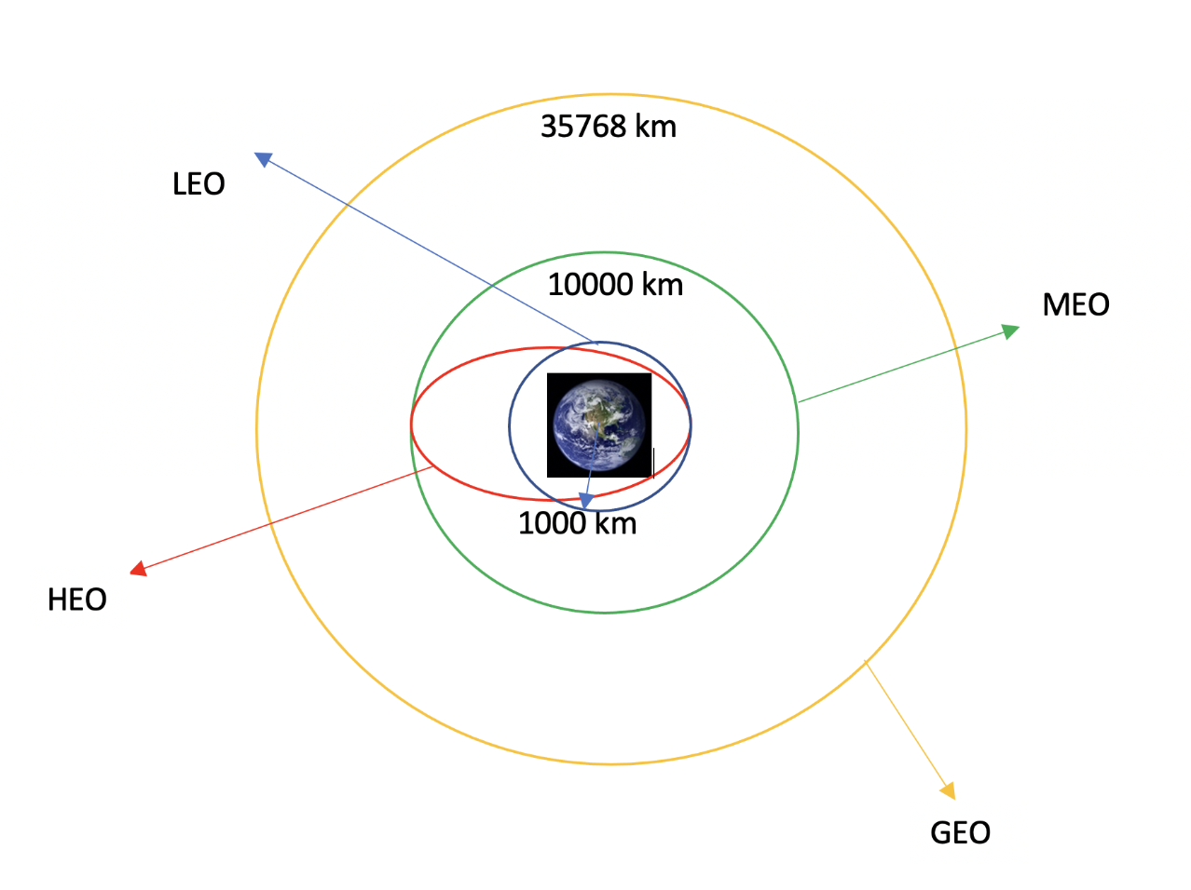
Data Wrangling
Data Wrangling is the process of cleaning and unifying complex data sets for easy access and Exploratory Data Analysis (EDA)
There were several cases where the booster did and did not land successfully:
Success: True Ocean, True RTLS, True ASDS
Failure: False Ocean, False RTLS, False ASDS
It was necessary to transform the outcome launch into a new categorical variable.
Some exploratory analysis was performed to have a better understanding of the occurrence of each orbit.
Link to workbook document

Slide 11
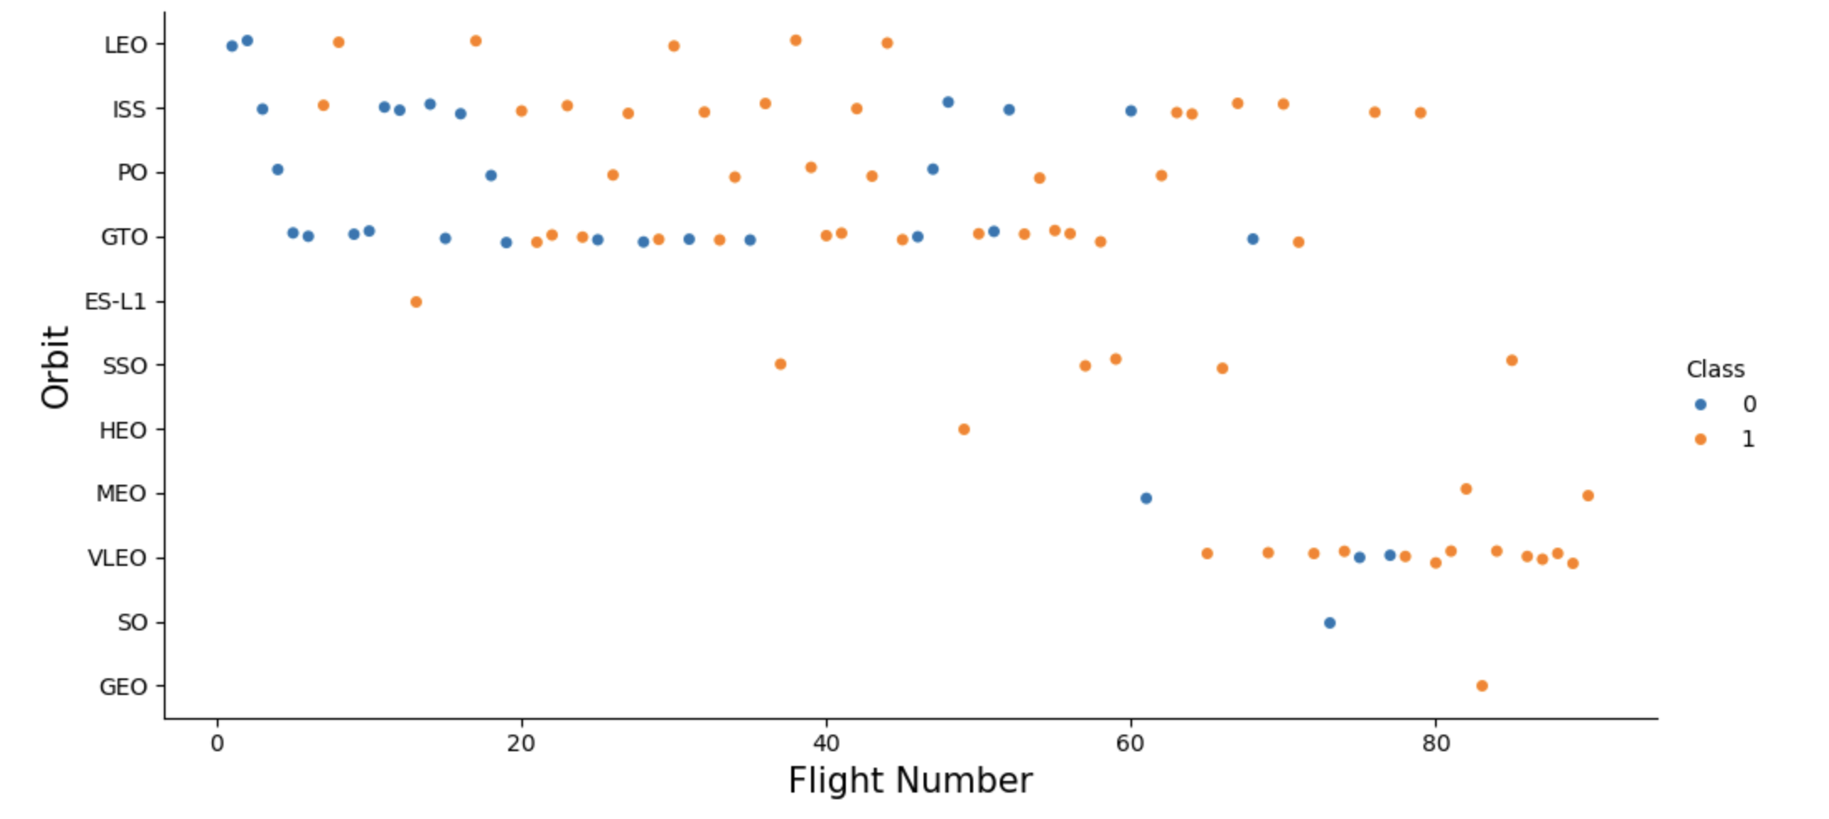
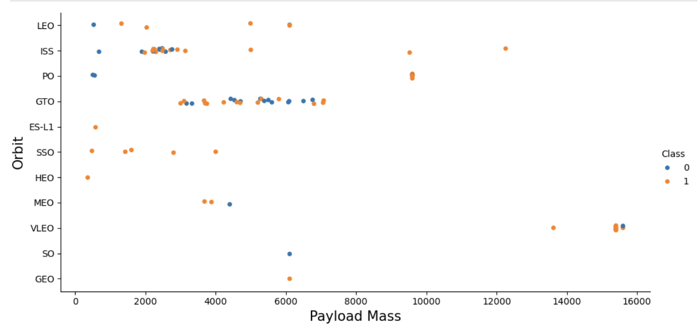
EDA with Data Visualization
Different scatter plots were graphed to find the relationship between variables:
Payload and Flight Number
Launch Site and Flight Number
Payload and Launch Site
Orbit and Flight Number
Success Rate and Orbit type
Orbit Type and Payload Mass
Scatter plots show which factors most affect the success of the landing outcomes. The correlation.
Bar graph which shows the relationship between numerical and categoric variables:
Success Rate vs Orbit
Line Graph which shows trends and makes predictions for unseen data:
Success rate vs Year
Link to workbook document

Slide 12
EDA with SQL
SQL queries were performed:
Display the names of the unique launch sites in the space mission
Display 5 records where launch sites begin with the string 'CCA’.
Display the total payload mass carried by boosters launched by NASA (CRS)
Display average payload mass carried by booster version F9 v1.1
List the date when the first successful landing outcome in the ground pad was achieved.
List the names of the boosters which have success in drone ships and have payload mass greater than 4000 but less than 6000kg
List the total number of successful and failed mission outcomes
List the names of the booster versions which have carried the maximum payload mass.
List the records that will display the month names, failure outcomes in drone ship, booster versions, and launch site for the months in the year 2015.
Rank the count of landing outcomes (such as Failure (drone ship) or Success (ground pad)) between the date 2010-06-04 and 2017-03-20, in descending order.
Link to workbook document

Slide 13
Build an Interactive Map with Folium
For visualization of launch sites, a marker with a circle around and a label with the name was added.
Green and Red markers were added to indicate the launch outcome( success or failure)
Using the Haversine’s formula for distance calculation was used to answer the following question:
How close are the launch sites to railways, highways, and coastlines?
How close are the launch sites to nearby cities?
Some lines with labels were added to indicate these distances.
Link to workbook document

Slide 14
Build a Dashboard with Plotly Dash
An interactive dashboard with Plotly Dash was built to plot graphs with different data. The components were:
Dropdown: allows users to choose all launch sites or a specific one (dash_core_components.Dropdown)
Pie chart: shows the total successful launches count for all sites and the success and failed counts for a specific site if it was chosen with the dropdown component. (plotly.express.pie)
RangeSlider: Allows users to select a payload mass in a fixed range (dash_core_components.RangeSlider).
Scatter chart: Shows the relationship between Success and Payload Mass (plotly.express.scatter)
Link to code

Slide 15
Predictive Analysis (Classification)
Classification models used:
Logistic Regression
Support Vector Machine
Decision Tree
K-nearest Neighbors
Model Evaluation
Comparison of results
Check the accuracy of each model.
Tune hyperparameters for each ML model.
Plot the confusion matrix
Data preparation and standardization
Load
Transform
Set the parameters for each algorithms for GridSearchCV
Different accuracy score were used.
Split into training and test datasets.
Fit de models
Link to workbook document

Slide 16
Results
The results will be categorized into 3 main results:
Exploratory data analysis results
Interactive analytics demo in screenshots
Predictive analysis results

Slide 17

Section 2

Slide 18
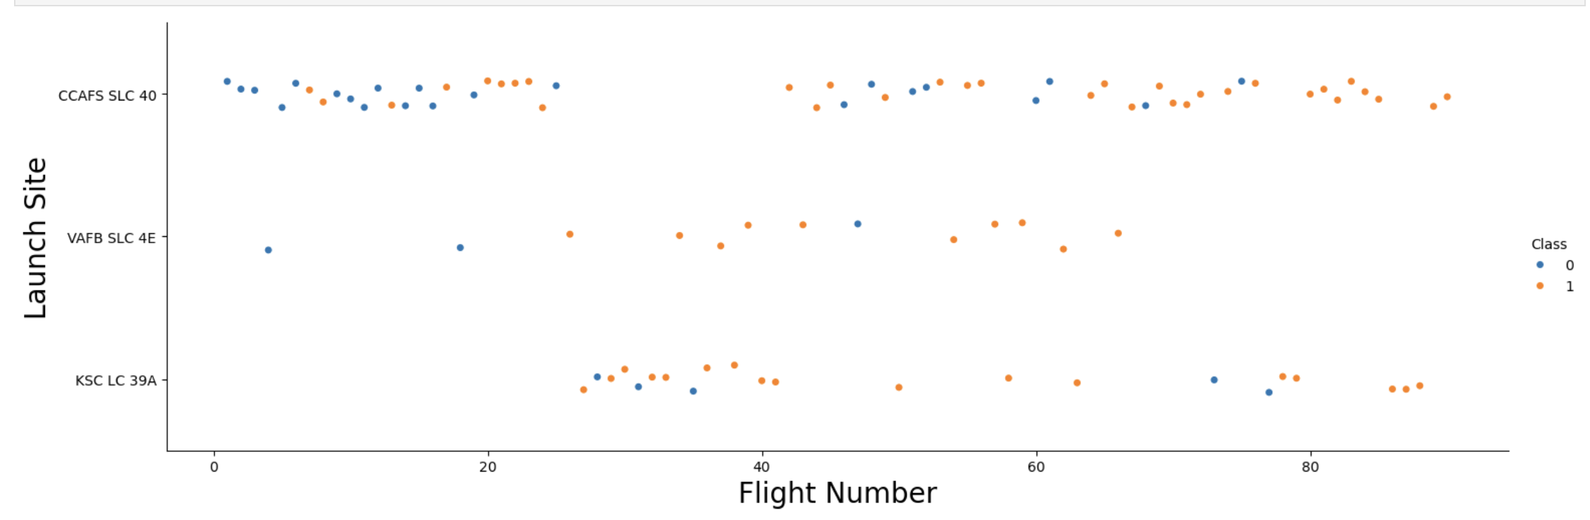
Flight Number vs. Launch Site
The earliest flights all failed while the latest flights all succeeded in each Launch Site.
The general success rate improved with each launch.
CCAFS SLC 40 launch site has around the half total number of launches and the most recent ones were successful
VAFB SLC 4E and KSC LC 39A have higher success rates.

Slide 19
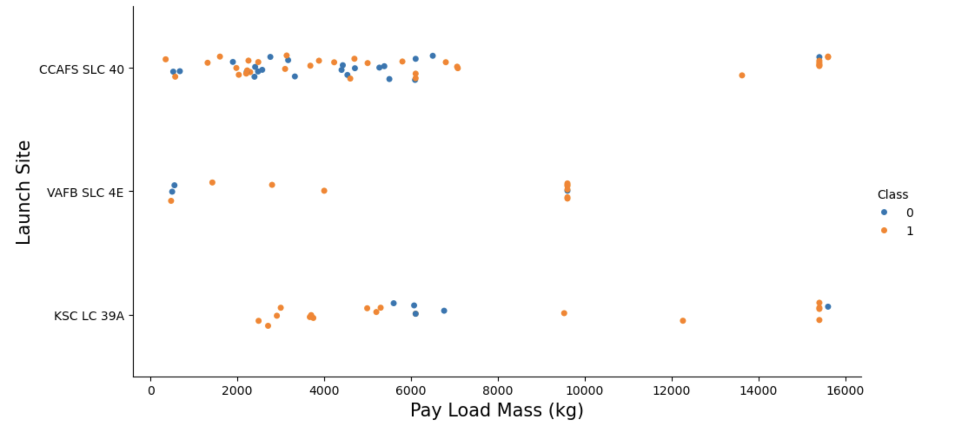
Payload vs. Launch Site
VAFB-SLC launch site there are no rockets launched for heavy payload mass(greater than 10.000kg)
Payloads over 8,000 kg have an excellent success rate.

Slide 20
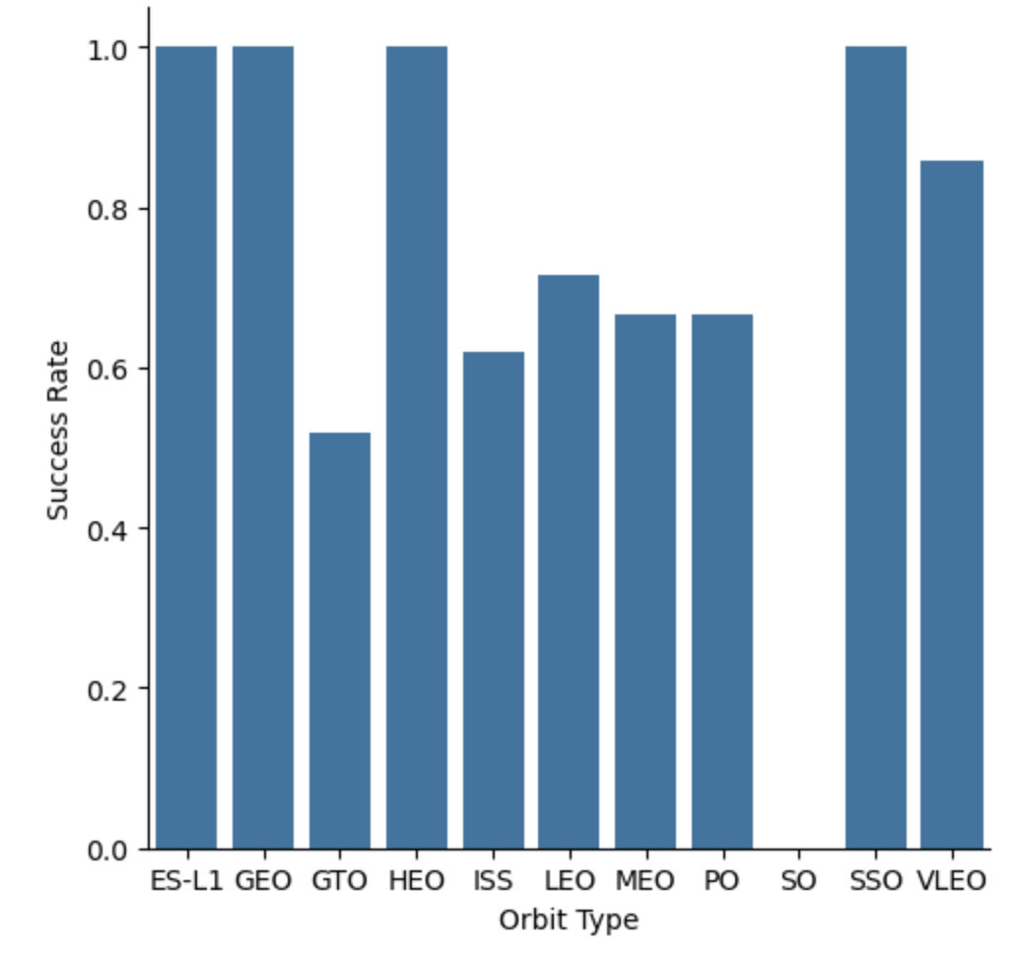
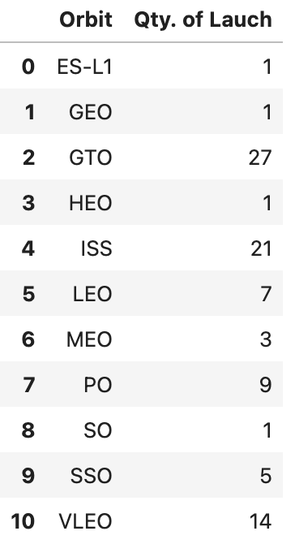
Success Rate vs. Orbit Type
Orbits with a 100% success rate have only one launch:
ES-L1, GEO, HEO
While there is one 100% success rate with more launches and is better to do statistics:
SSO
Orbits with 0% success rate and just 1 launch is:
SO
Orbits with a success rate between 50% and 85%:
GTO, ISS, LEO, MEO, PO

Slide 21
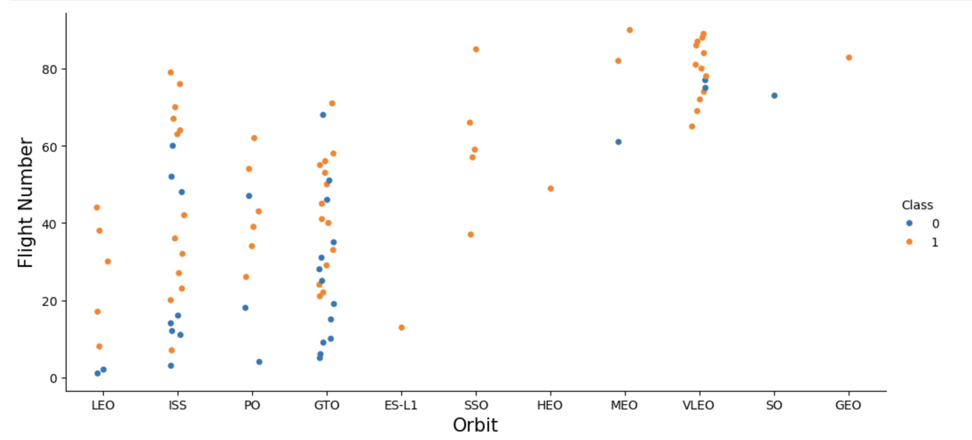
Flight Number vs. Orbit Type
LEO orbit success appears related to the number of flights;
There seems to be no relationship between flight numbers when in GTO orbit.

Slide 22
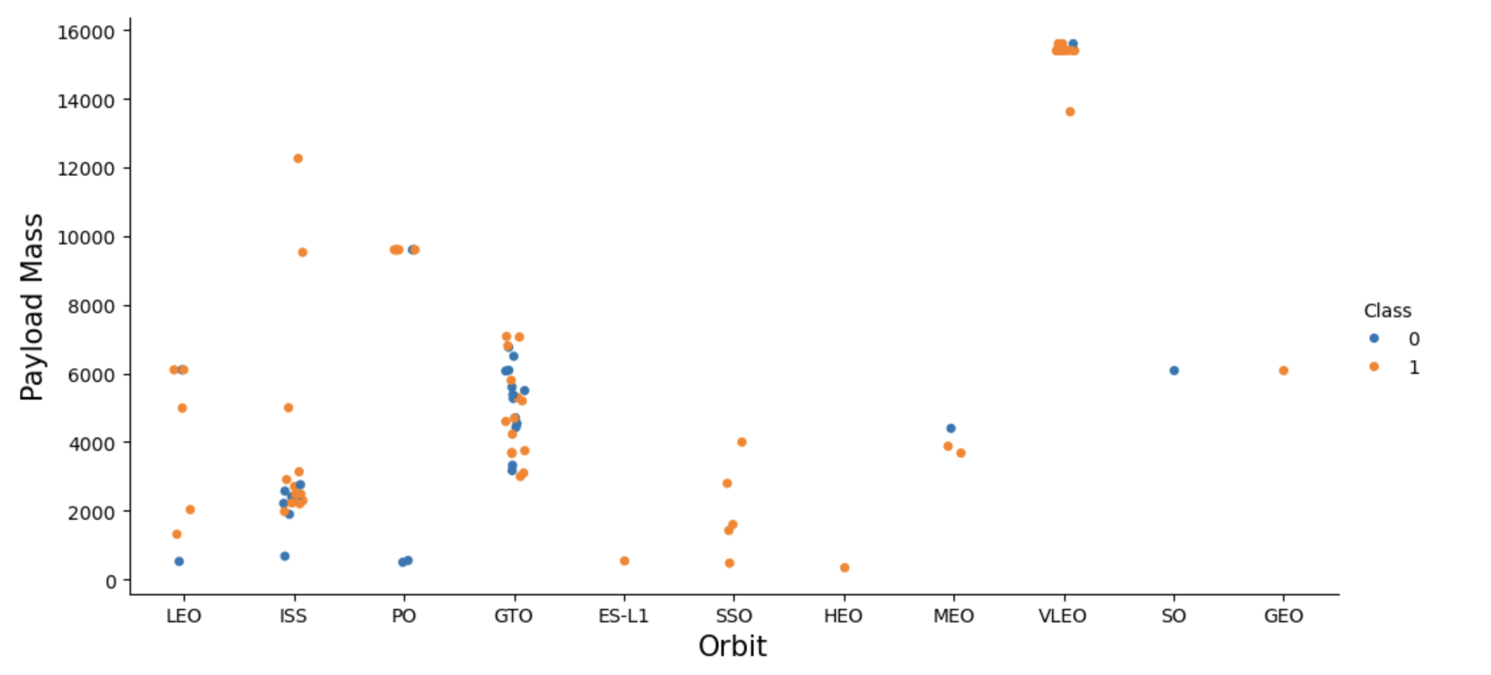
Payload vs. Orbit Type
Heavy payloads for a successful landing or positive landing rate are more likely for LEO, ISS, and Polar. And in the opposite for MEO and VLEO orbits.
For GTO cannot be distinguished this well as both positive landing rate and negative landing (unsuccessful mission), both there here.
Orbits that only has 1 occurrence should be excluded until have more date.

Slide 23
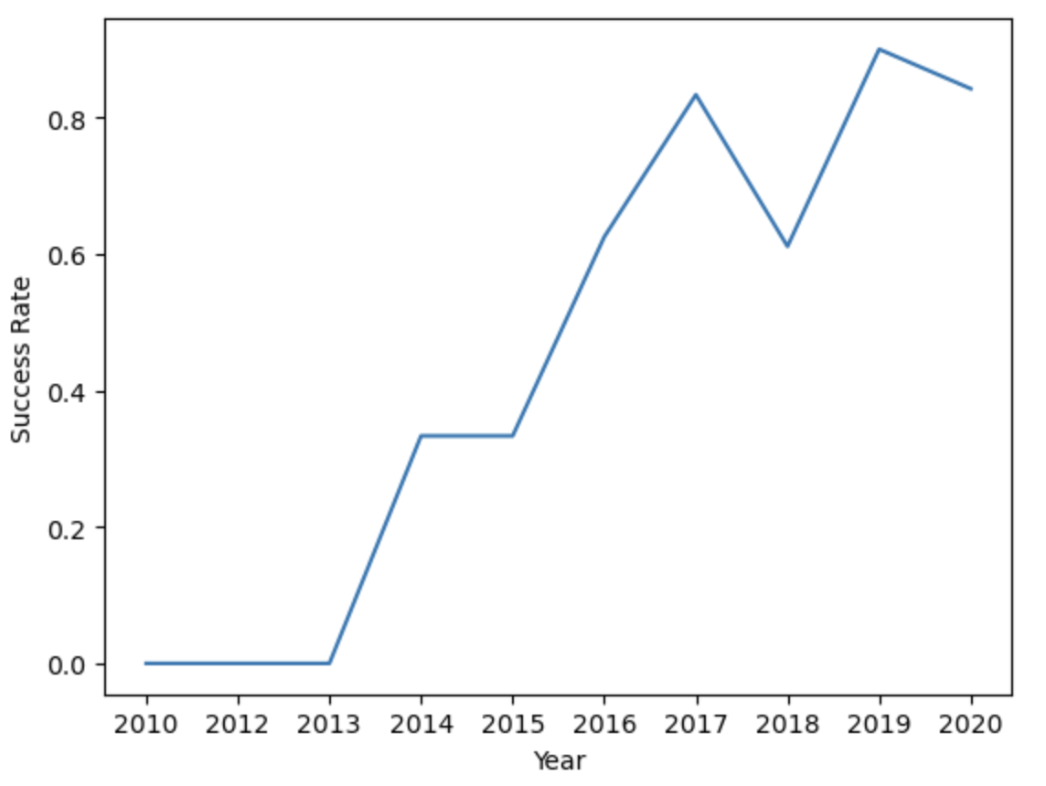
Launch Success Yearly Trend
From 2013 until 2017 the success rate keep increasing.

Slide 24
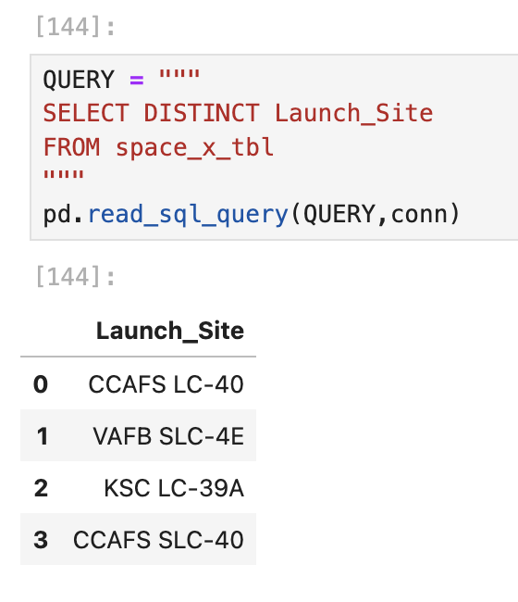
All Launch Site Names
The keyword DISTINCT was used to show unique launch sites.

Slide 25
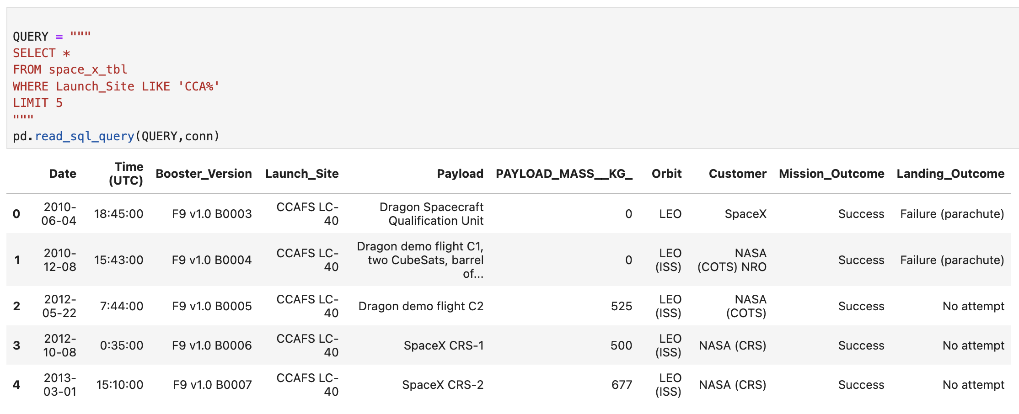
Launch Site Names Begin with 'CCA'
A query to show 5 launch records that start with ‘CCA’ was executed.

Slide 26
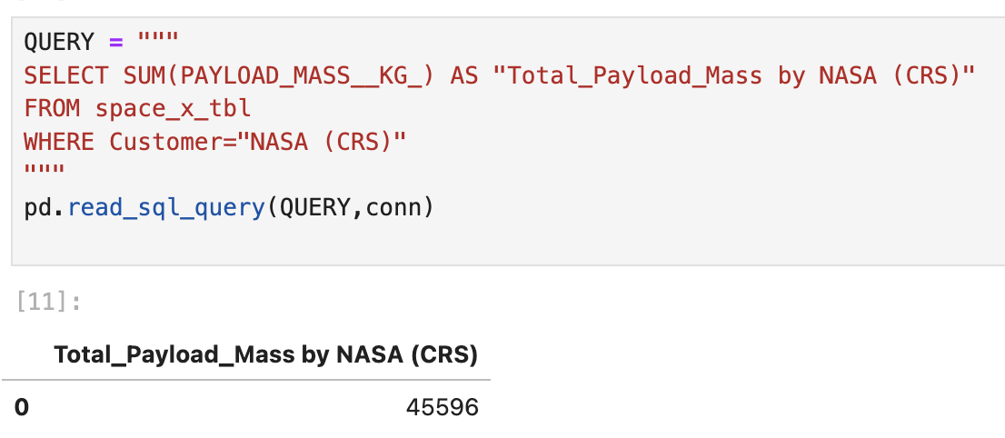
Total Payload Mass
The total payload carried by boosters from NASA was calculated. It is a total of 45.596Kg.

Slide 27
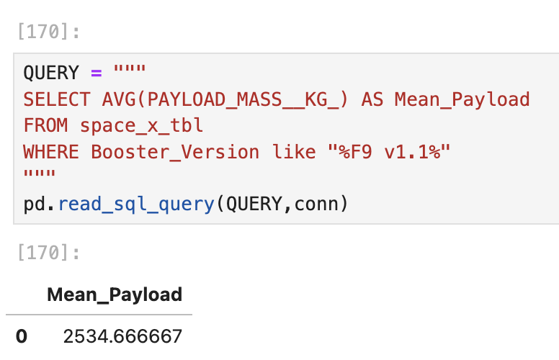
Average Payload Mass by F9 v1.1
For the booster version F9 v1.1, the average payload mass carried was calculated as 2.928,4

Slide 28
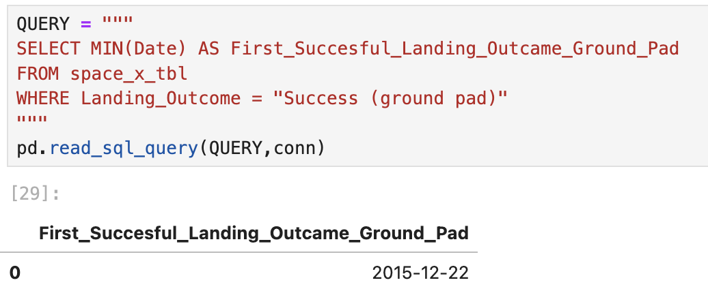
First Successful Ground Landing Date
The MIN() function was used to find the result from the “Landing_Outcome” column.
It was observed that the first landing outcome on a ground pad was on the: 22nd of December of 2015.

Slide 29
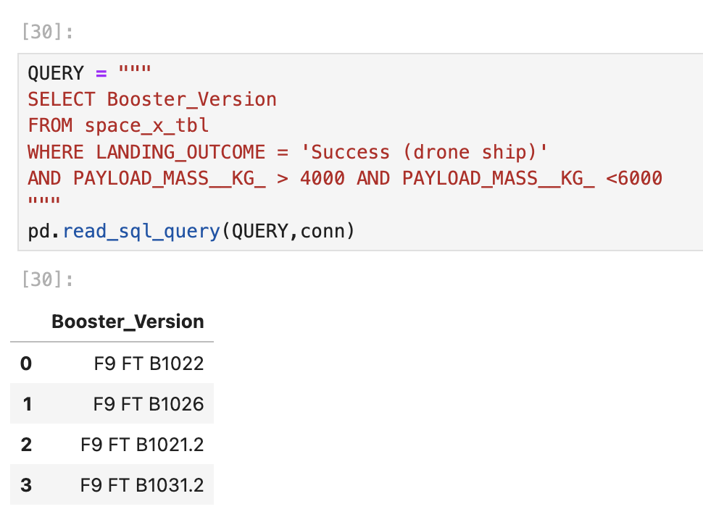
Successful Drone-Ship Landing with Payload between 4000 and 6000
The busters which have a successful landing in drone-ship and with a payload between 4000kg and 6000 kg were queried.

Slide 30
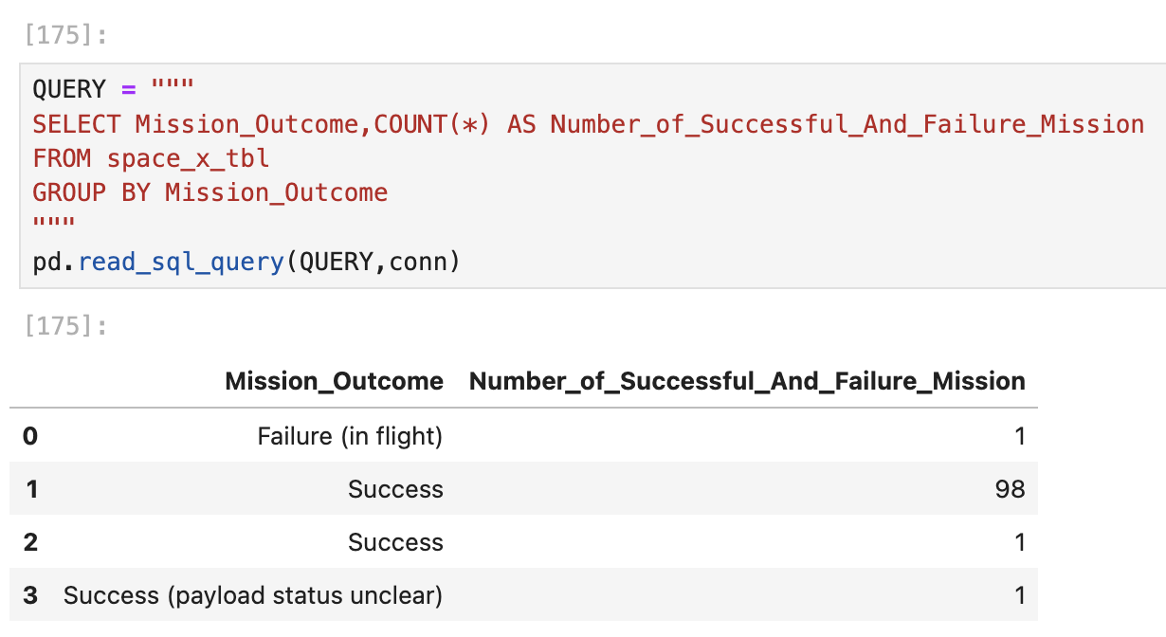
Total Number of Successful and Failure Mission Outcomes
The total success and failure mission outcomes number was queried.
There were 100 success and 1 failure.

Slide 31
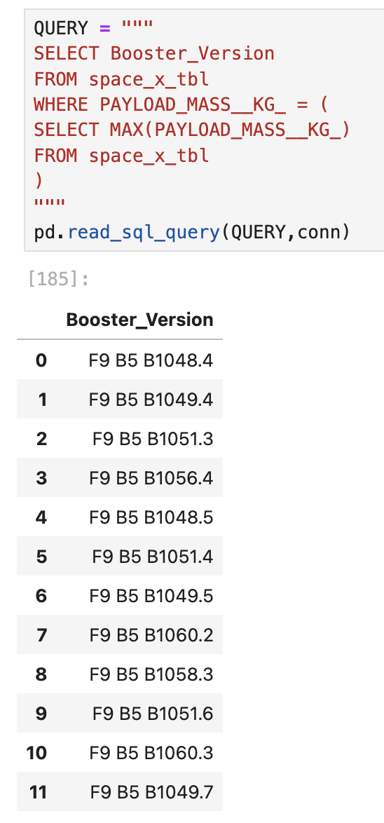
Boosters Carried Maximum Payload
The boosters which have carried the maximum payload mass were queried. A subquery was needed to find the maximum payload first.

Slide 32
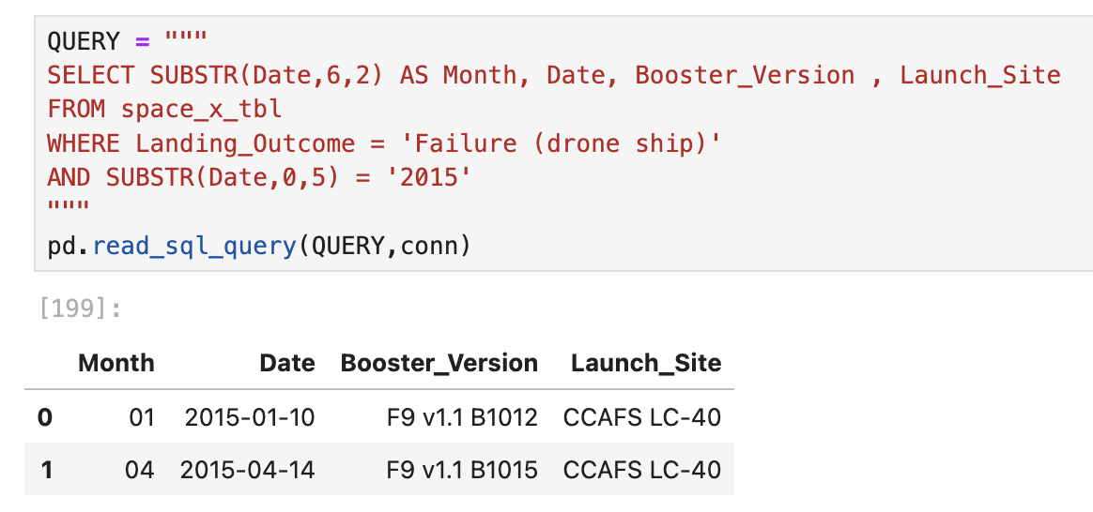
2015 Launch Records
2015 was a year when the success rate started to increase.
There were a couple of failed landing outcomes for a drone ship in the 2015 year which were listed.

Slide 33
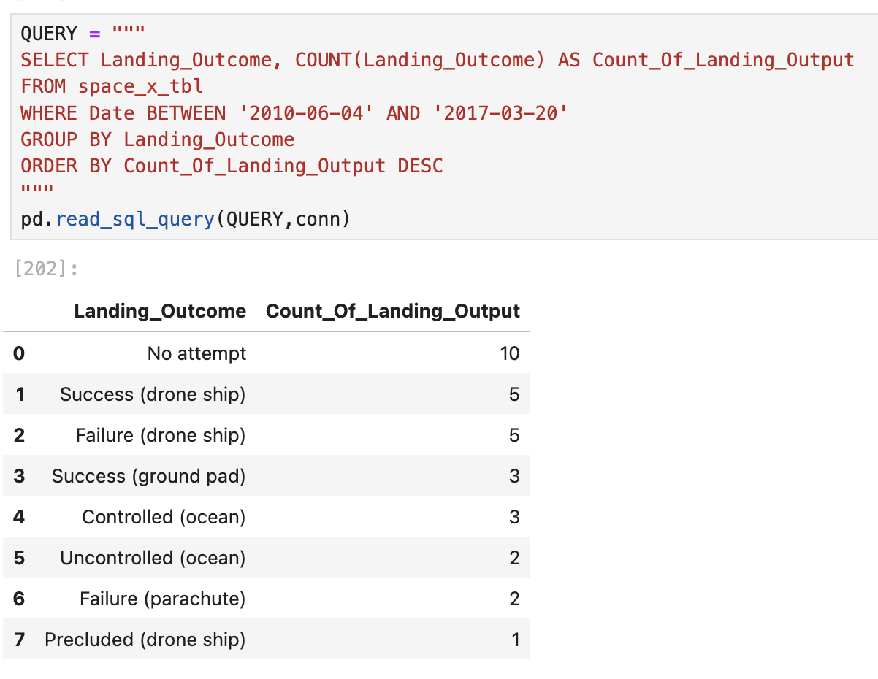
Rank Landing Outcomes Between 2010-06-04 and 2017-03-20
A rank of the count of kind of landing outcomes between 2010-06-04 and 2017-03-20 dates were queried in descending order.
There was a great number of no attempts of landing during these years.

Slide 34

Section 3

Slide 35
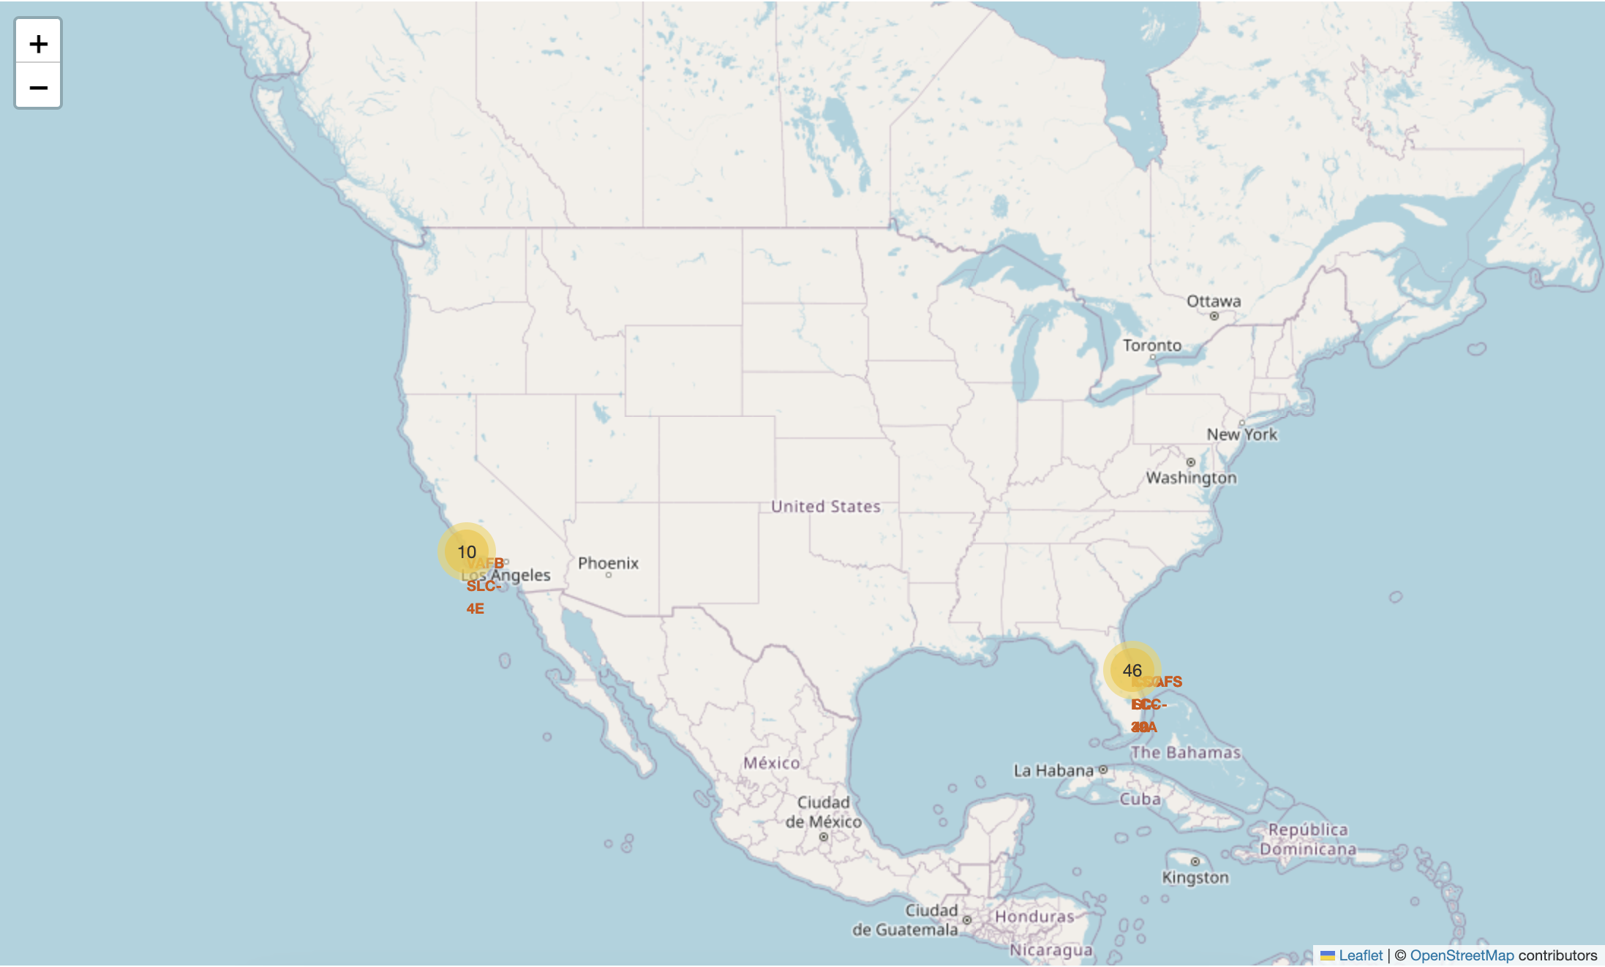
Folium Map - Launch Sites
As can be depicted the launch sites are most close to the Ecuador line inside the USA territory. At the same time close to the cost in both sides of the county.

Slide 36
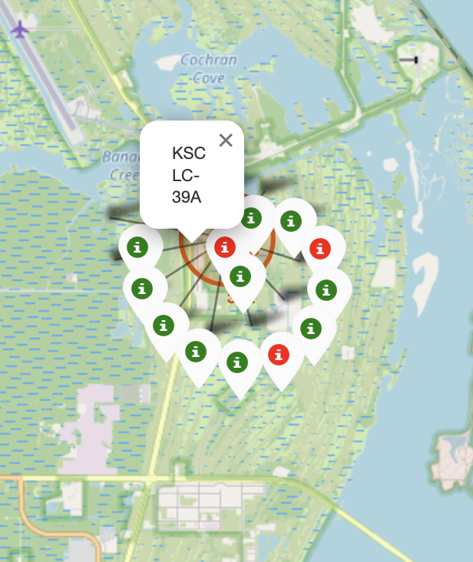
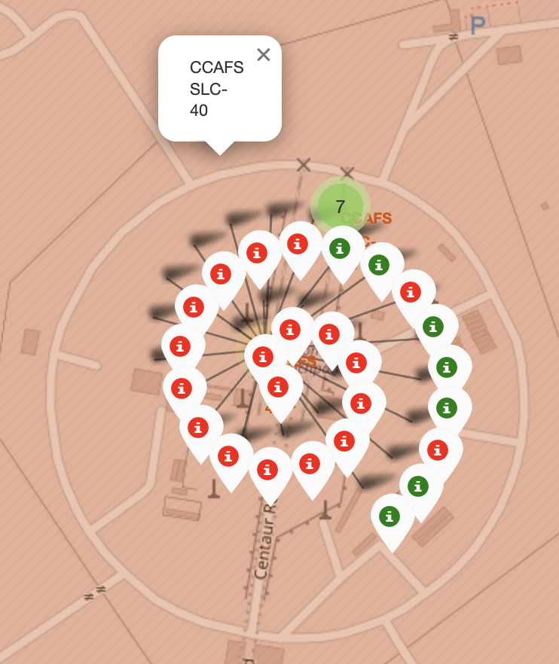
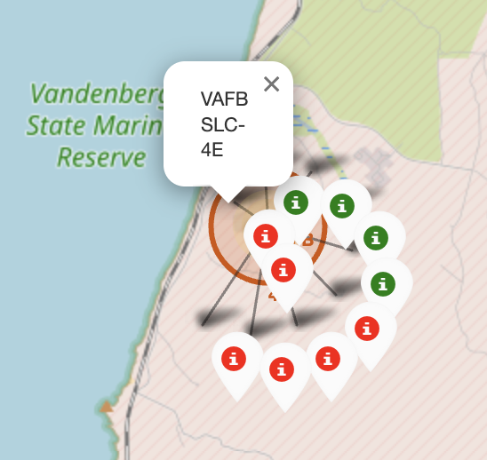
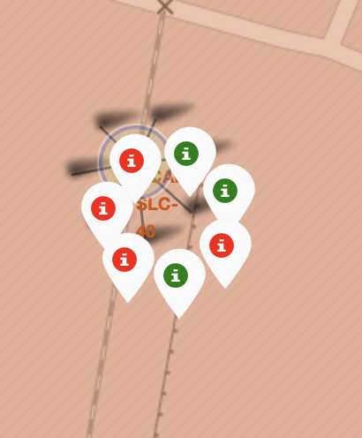
Folium Map – Launch sites with color marker
California Launch Site
Florida Launch Sites
Green Marker shows successful launches and Red Marker shows failures.

Slide 37
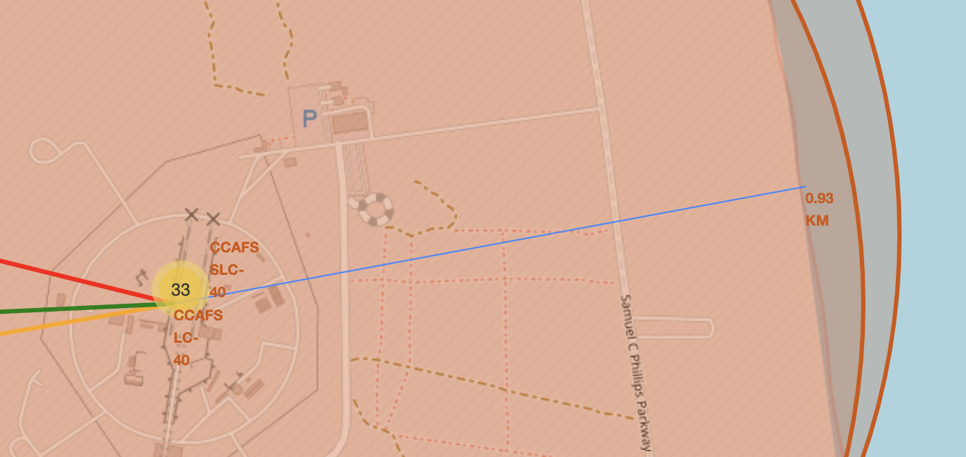
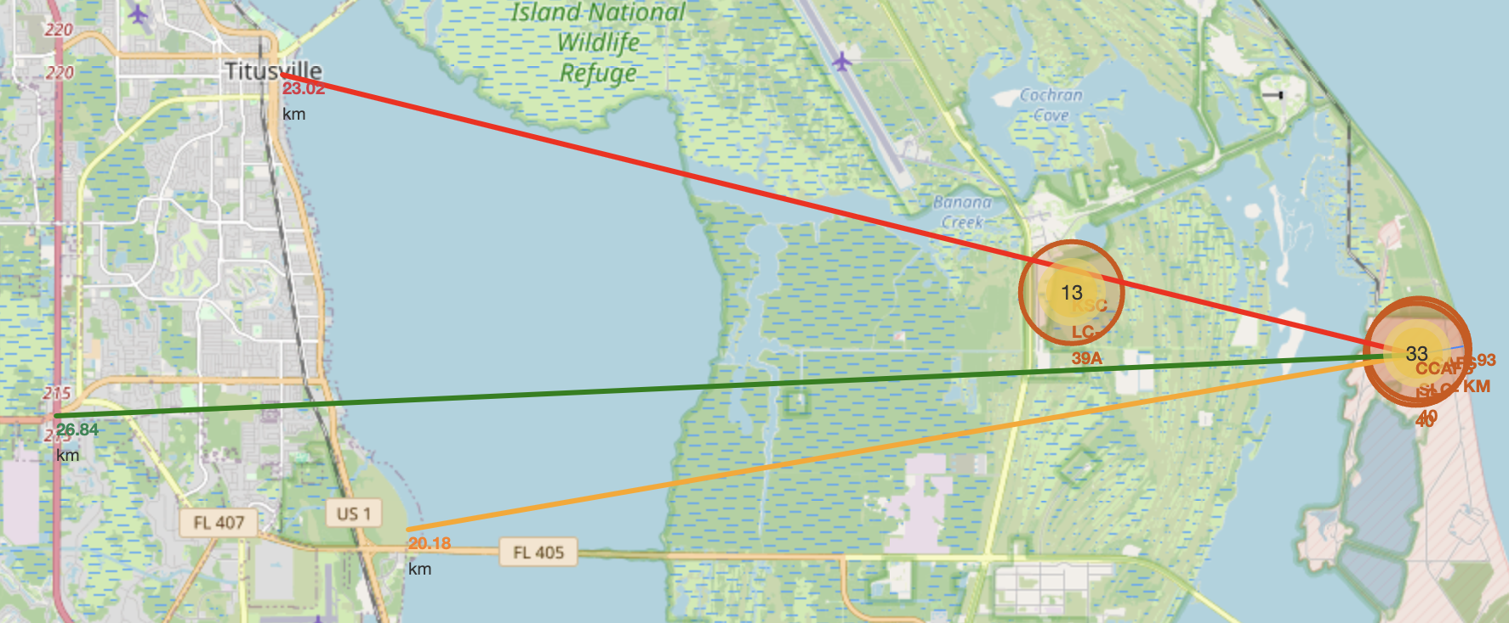
<Folium Map Screenshot 3>
It was taken as a reference to a launch site with the highest number of launches.
The close railways, highways, and cities are more than 20km far away.
Meanwhile, the cost line is 0,93 km far away.

Slide 38

Section 4

Slide 39
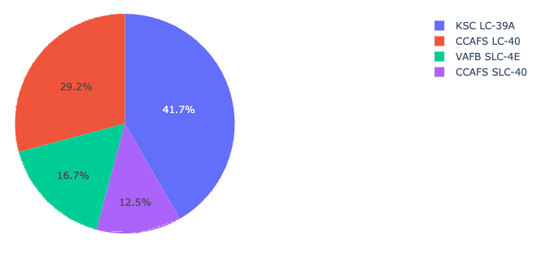
Total success launches by site
KSC LC-39A had the most successful launches from all the sites.

Slide 40
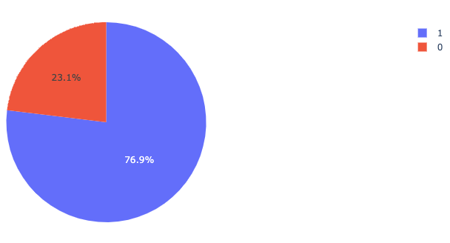
Launch-success ratio for KSC LC-39A
KSC LC-39 who has the highest percentage of success, achieved a 76,9% success rate while getting a 23.1% failure rate.

Slide 41
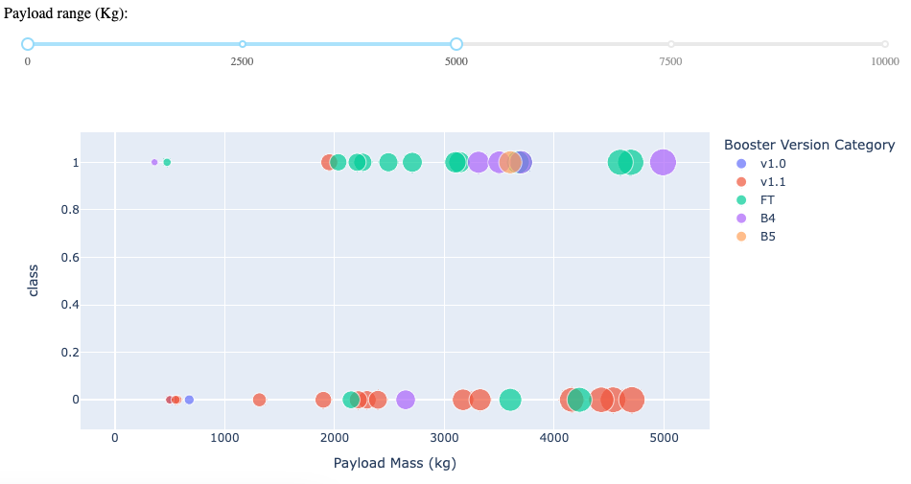
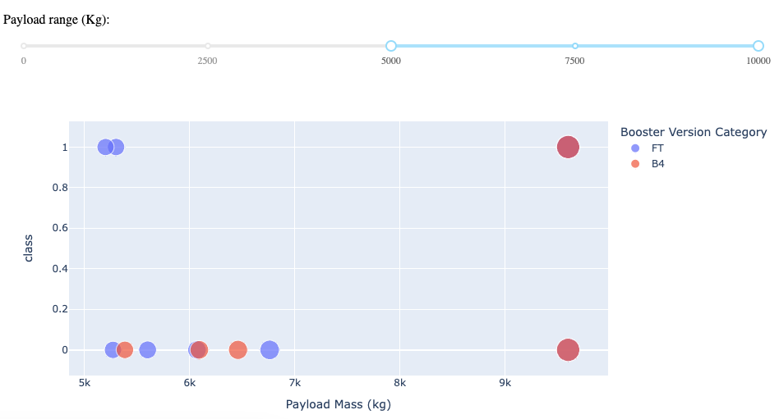
Launch Outcome vs Payload
Can be depicted that low-weight payloads have a success rate higher than heavy-weight payloads.
Low-weight Payload (0kg – 5.000kg)
Heavy-weight Payload (5.000kg-10.000kg)

Slide 42

Section 5

Slide 43
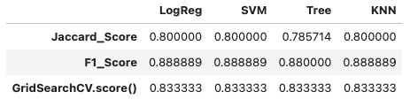
Classification Accuracy
For different models, the accuracy was scored :
LogReg: Logistic regression
SVM: Support Vector Machine
Tree: Decision tree
KNN: K-nearest neighbors
All the performed methods were similar.
The preferred to keep working in the future is the KNN:

Slide 44
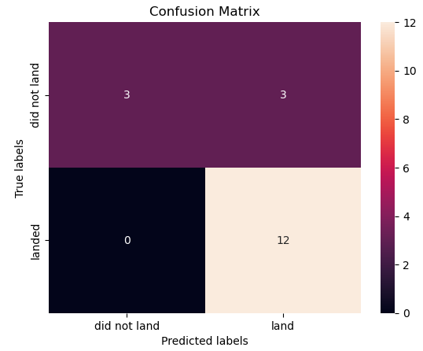
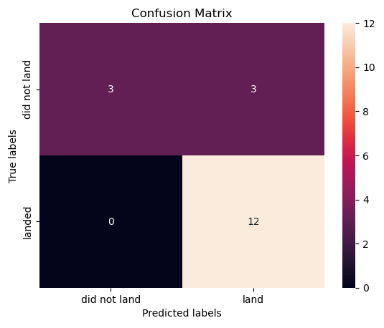

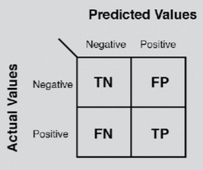
Confusion Matrix
Logistic regression
Support Vector Machine
As the accuracy tests were similar, the confusion matrices were also similar except for the decision tree which had some problems.
The biggest problem of these models is these false positives, i.e. unsuccessful landing marked as successful landing by the classifier.
Decision Tree
KNN: K-nearest neighbors

Slide 45
Conclusions
It was possible to perform extraction, transformation, and exploratory data analysis successfully to have a better understanding of the problem.
Four Machine Learning models were launched to find a way to predict the launch outcome and a high accuracy was achieved but the false positives are the biggest problem of the models.
Low-weighted payloads (below 5000kg) performed better than heavy-weighted payloads.
The increase in success rate from 2013 ongoing is quite promising.
The site KSC LC-39A was identified as the most successful launch site with a 76,9%
The GEO, HEO, and SSO orbits were correctly identified as having the highest success rates.
The SSO orbit has a 100% success rate with 5 launches, more launches are needed to make statistics, but it generates good expectations.

Slide 46


